Slide 1
Business-To-Business Branding

Slide 2
Overview
Importance of B2B branding
B2B branding approaches
Brand communication
  Traditional
  Emergent
Inbound marketing
Content marketing

Slide 3
Why B2B Branding Matters
Brands drive purchase decisions
Brands drive differentiation
Strong B2B brands command as much as 20% higher margin than weak brands

Slide 4
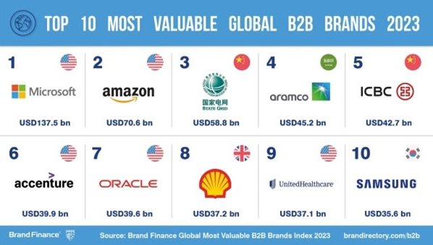
Recent B2B Brand Equity Estimates by BrandFinance

Slide 5
B2B vs. B2C Branding
Differences…
…and similarities!

Slide 6
B2B Branding Approaches
Traditionally, B2B firms focused on:
  Their capabilities in managing the 4Ps (where product reigned supreme)
  Channel mastery
Increasingly, firms recognize an interactive marketplace where customers hold more power
“Consumerization” of B2B branding
Value “co-creation” is paramount to building brand equity

Slide 7

Traditional B2B Communications
Media advertising
Trade journal advertising
Direct mail
Brochures
Specialty advertising
Sponsorships/Event marketing
Trade shows/Exhibits
Directories

Slide 8
Emergent B2B Communications
E-mail
Internet
  Search Engine Optimization (SEO)
  Inbound Marketing
    “Content Marketing”
    Social Media
Mobile

Slide 9
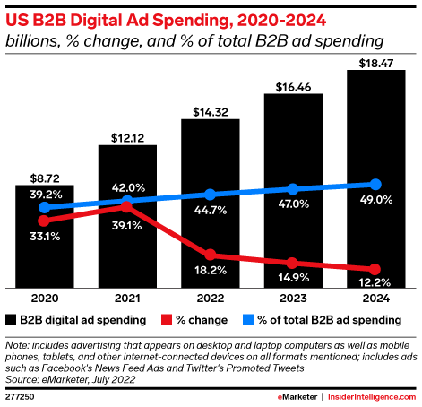
B2B Digital Advertising

Slide 10
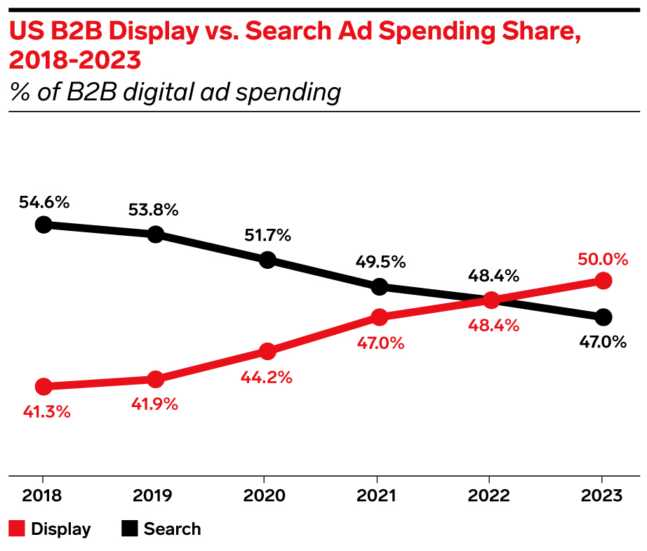
B2B Advertising Trends

Slide 11
B2B Social Media Use is Pervasive
LinkedIn (93%)
Twitter (87%)
Facebook (84%)
YouTube (74%)

Slide 12
Inbound Marketing
Inbound marketing is defined as promoting a company through tools such as blogs, podcasts, video, eBooks, e-newsletters, white papers, social media and other forms of content marketing that serve to attract customers closer to the brand.
These tools stand in contrast to “outbound marketing”, comprised of traditional “interruption” marketing, such mass media advertising and sales calls.

Slide 13
Content Marketing Definition
Content marketing is the practice of creating and distributing relevant and valuable content to attract, acquire, engage, and retain a target audience—the art of communicating without “selling”.
Key Content Marketing Tools (an incomplete list)
  Social media
  Video
  Blogs
  eNewsletters

Slide 14
Content Marketing: State of the Art
Used by 88% of B2B marketers, but…
Only 32% of B2B marketers have a documented CM strategy
B2B marketers with a documented CM strategy are 60% more effective

Slide 15
Content Marketing Challenges
Producing engaging content (60%)
Measuring content effectiveness (57%)
Producing content consistently (57%)
Measuring the ROI of the CM program (52%)

Slide 16
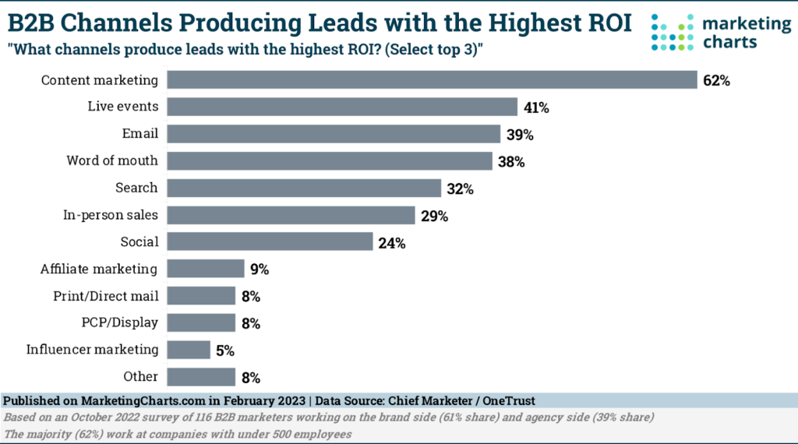
B2B Marketing ROI

Slide 17
Managing Content Marketing
Generate content in-house (56%)
Outsource exclusively (1%)
Utilize a blended approach (43%)

Slide 18
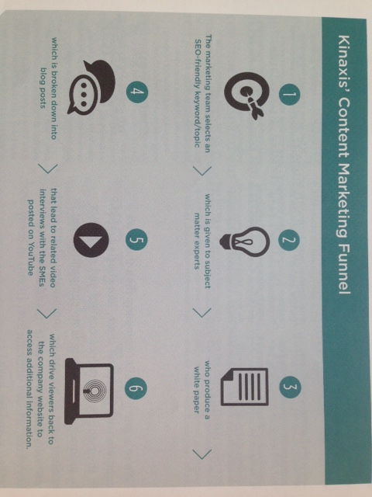
Kinaxis’ Approach

Slide 19


B2B Branding Guidelines
Adopt a corporate branding strategy
Clearly differentiate individual products
Make linkages to non-product associations

Slide 20

B2B Ad from Boise Cascade Office Products

Slide 21
Conclusion
Are there strong B2B brands that sell to your firm?
If your firm is in the B2B market, does it have a strong brand?
Does your B2B brand use the full array of emergent communication tools?

Slide 22
End of Lecture

